Slide 1
SED Final Project
web2py
Team2

Slide 2
Outline
Briefly introduce web2py
Request to Controller
Server
Rewrite and parsing incoming URLs
WSGI hooks
Cookies & Session
Run Application
Services
Views
Cron & Scheduler
PyDAL
Conclusion

Slide 3
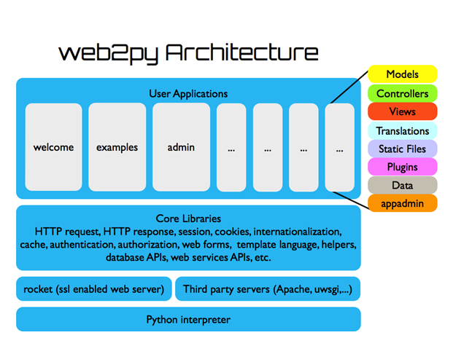
Notes:
bottom: interpreter
server
the libraries
the applications
consists for its own MVC design

Slide 4
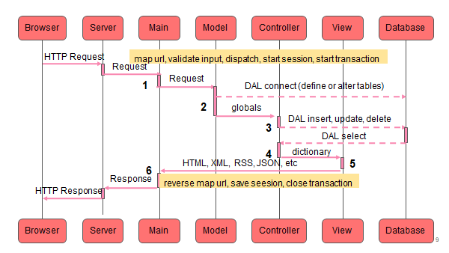
Notes:
Server handles multi-threading
"main" is the main WSGI application
performs all common tasks
The dashed arrows represent communication with the database engine(s)
raw SQL
using the web2py Database Abstraction Layer
The dispatcher maps the requested URL to a function call in the controller

Slide 5
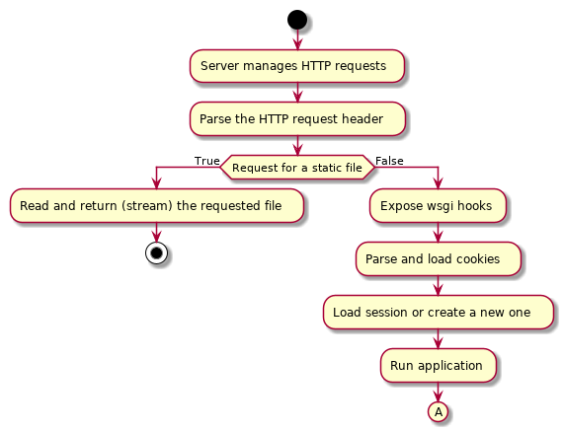
Requests to controller

Slide 6
Requests to controller

Slide 7
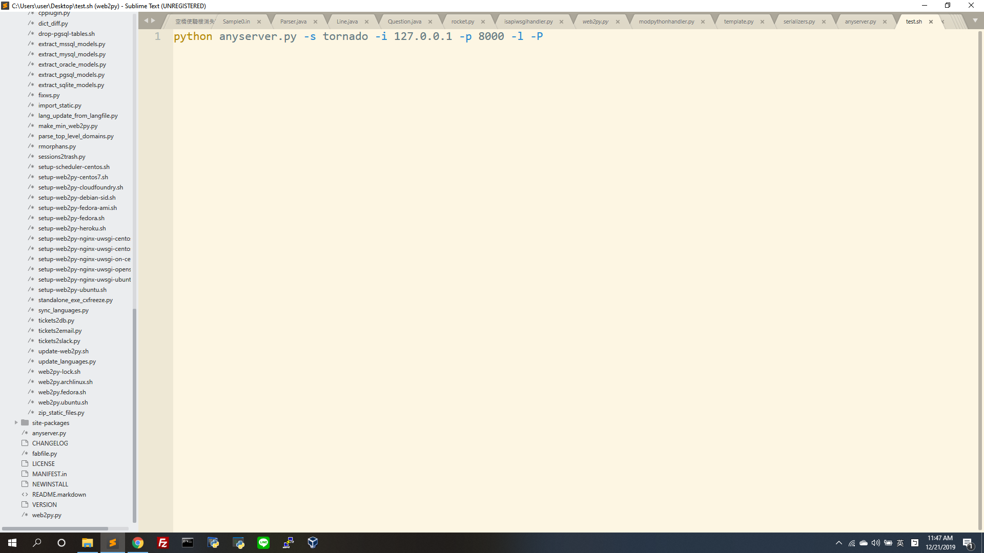
Server
web2py includes a built-in server Rocket.
web2py can also be runned with WSGI compatible servers: E.g. paste, tornado, twisted, etc.
Run anyserver.py to start

Slide 8
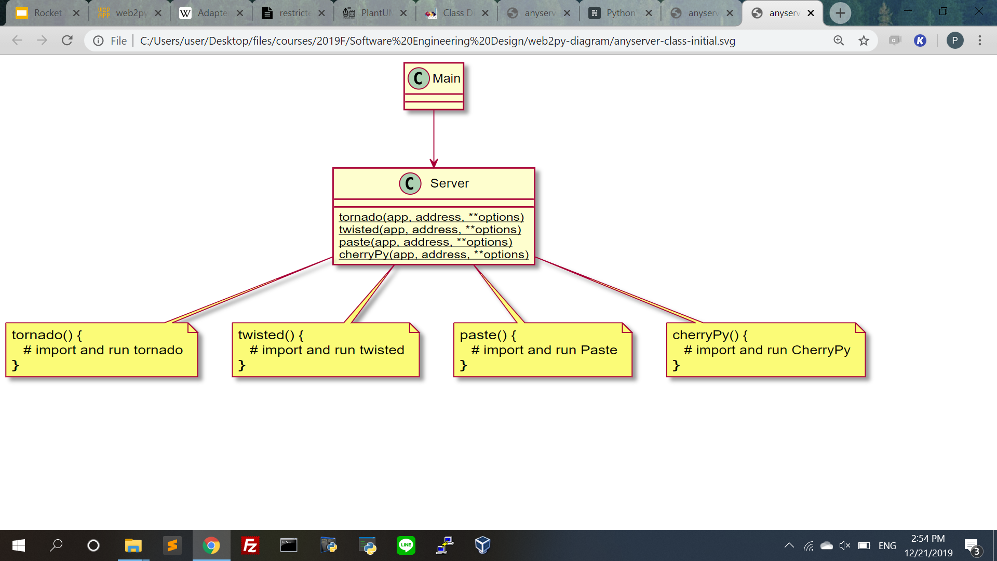
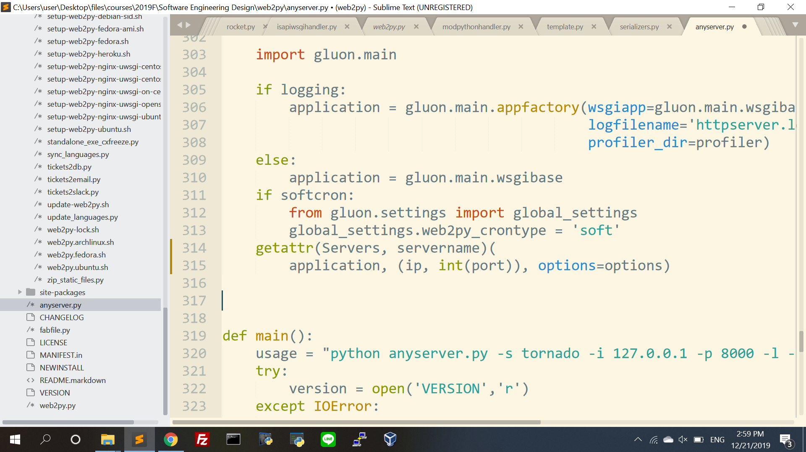
Class diagram

Slide 9
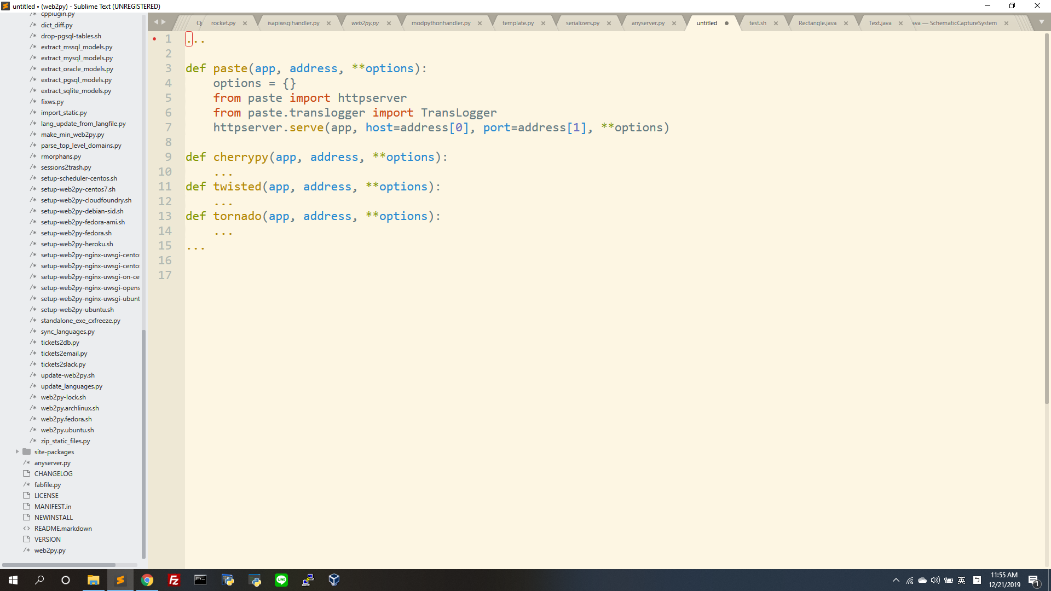
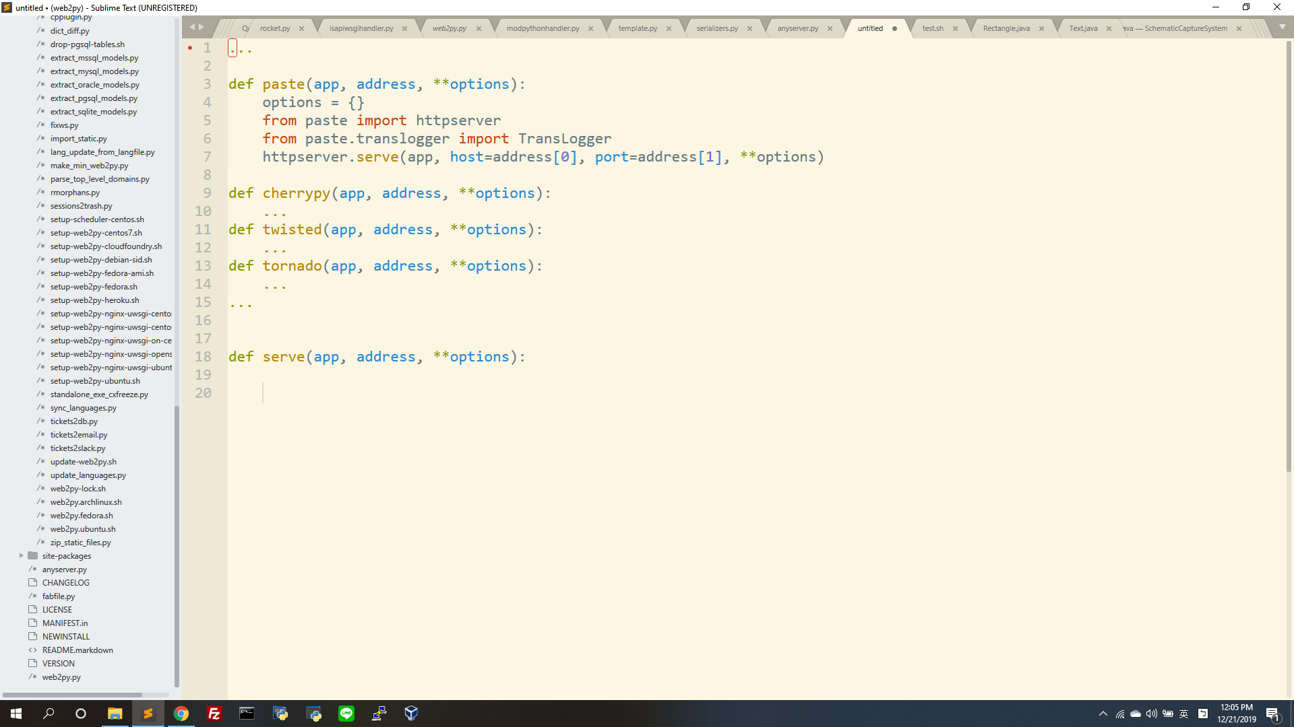
Code
Adapter
Adaptee
Adapter
Adapter
Adapter
Interface of adapter:

Slide 10
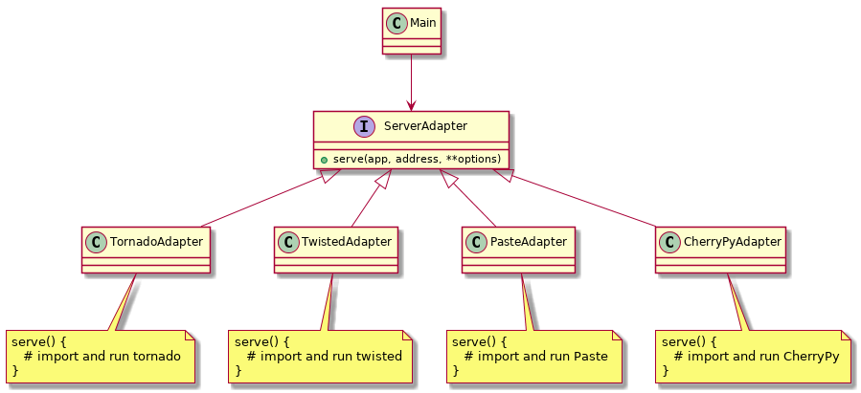
Adapter class diagram -- refactored

Slide 11
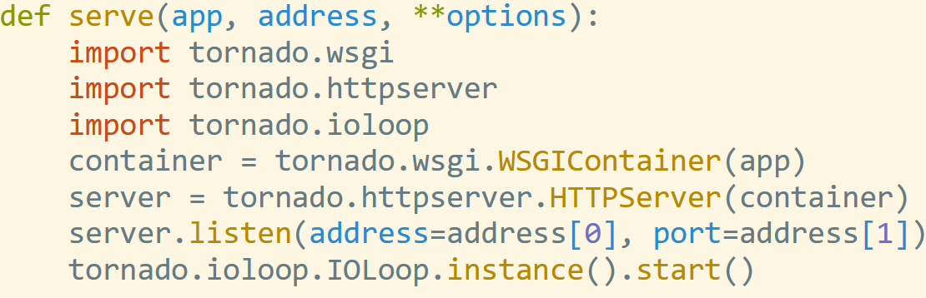
Adapter class diagram -- refactored (cont.)
Object Adapter Pattern
Adaptee

Slide 12
Rocket server
Rocket is a lightweight open source server According to Rocket’s documentation: “The HTTP 1.1 specification allows for a number of corner-case behaviors that are not regularly used. Because Rocket seeks to be fast and small, some of these features have been left out on purpose.”
Included in web2py as the default web server

Slide 13
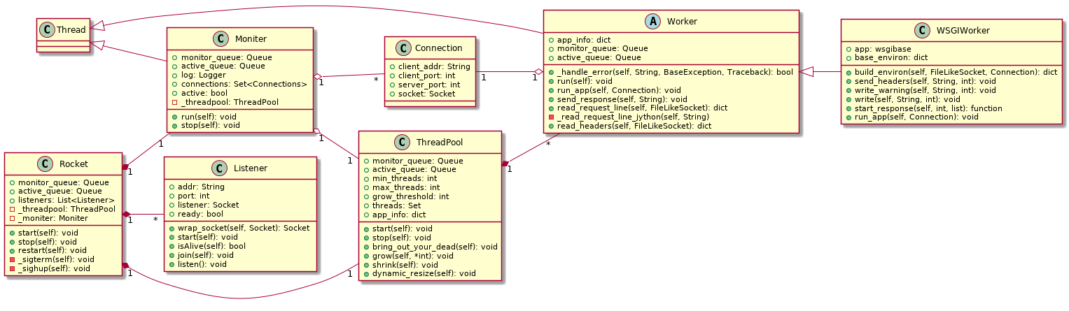
Design of Rocket: class diagram

Slide 14
Rocket: responsibility of each class
Listener: listens on an interface and accepts incoming connections.
Worker (subclass of Thread): Reads request headers & contents from socket.
WSGIWorker (subclass of Worker): It implements run_app() and is responsible of executing the WSGI application.
ThreadPool: pool of worker threads.
Monitor: It monitors connections; manages the size of ThreadPool.

Slide 15
Rocket: two queues
Active queue: Active connections are put into this queue by Listeners, and retrieved from this queue by Workers
Monitor queue: Timeout connections are put into this queue, and are monitored by the monitor class.

Slide 16
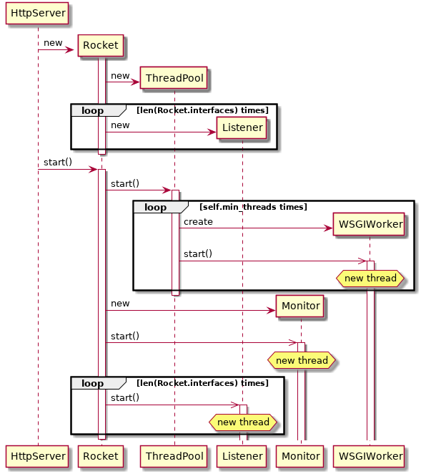
Sequence diagram: start-up

Slide 17
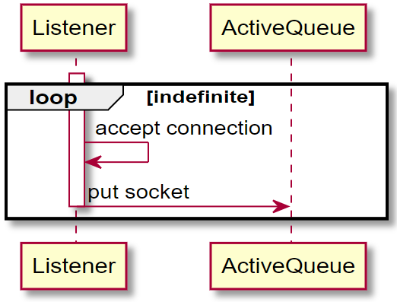
Sequence diagram: listening for incoming connections

Slide 18
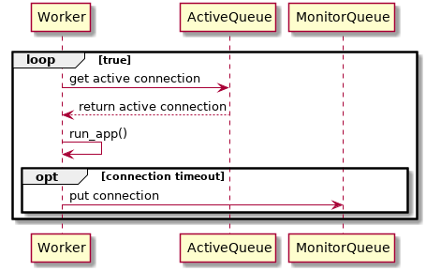
Sequence diagram: process connection

Slide 19
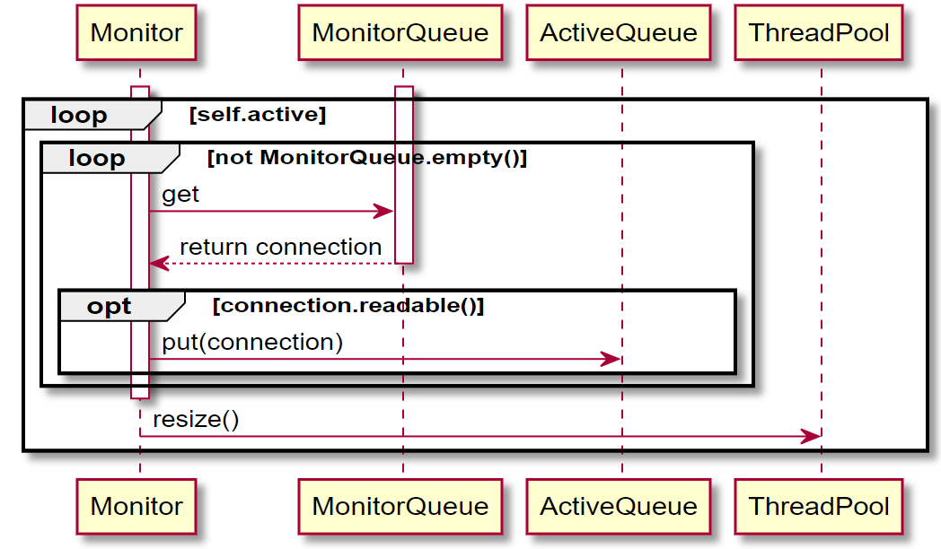
Sequence diagram: monitor connection status

Slide 20
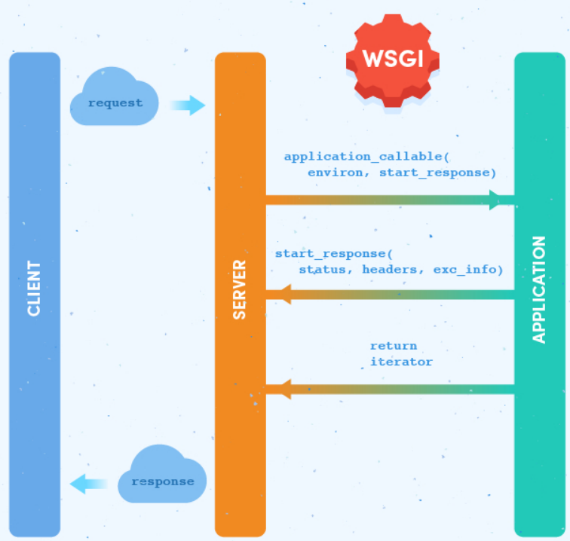
WSGI (Web Server Gateway Interface)
A simple calling convention for web servers to forward requests to web applications or frameworks written in the Python programming language
Between the server and the application, there may be one or more WSGI middleware components, which implement both sides of the API, typically in Python code

Slide 21
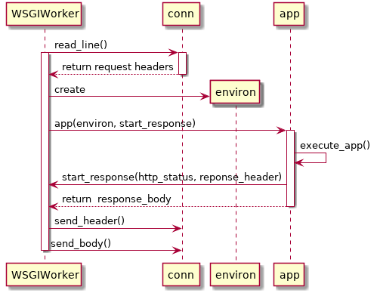
Sequence diagram: running the WSGI application

Slide 22
Request to controller

Slide 23
Rewrite and parsing incoming URLs
URL Rewrite
Motivation to rewrite incoming URLs
Handle legacy URLs
Simplify paths and make them shorter
Two distinct URL rewrite systems
The parameter-based system
The pattern-based system
Notes:
https://support.livebooks.com/hc/en-us/articles/207892666--Legacy-URL-Information
parameter-based system
for most use cases
pattern-based system
for more complex cases

Slide 24
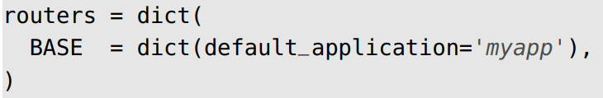
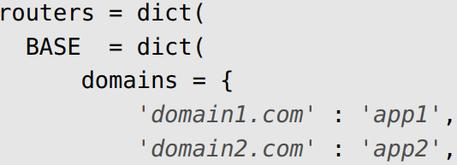
Rewrite and parsing incoming URLs (cont.)
Parameter-based system
Omit default application, controller and function names from externally-visible URLs (those created by the URL() function)
Map domains (and/or ports) to applications or controllers
Embed a language selector in the URL
The application name is no longer part of the URL
Domain mapping
Notes:
"default.py" is the controller that you need to edit, the one that is called by default when no controller is specified in the URL

Slide 25
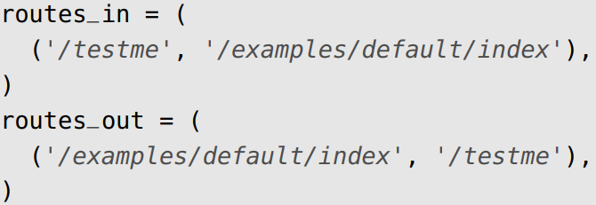
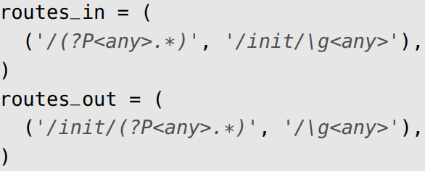
Rewrite and parsing incoming URLs (cont.)
Pattern-based system
Provide some additional flexibility for more complex cases
Instead of defining routers as dictionaries of routing parameters, you define two lists (or tuples) of 2-tuples
Each tuple contains two elements: the pattern to be replaced and the string that replaces it
To the visitor, all links to the page URL looks like /testme.
Get rid of the application prefix from the URLs

Slide 26
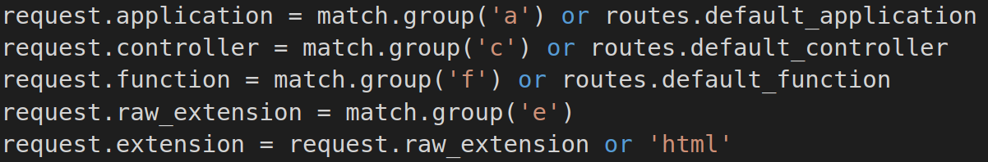
Rewrite and parsing incoming URLs
URL Parsing
For static pages:
/<application>/static/<file>
For dynamic pages:
/<a:application>[/<c:controller>[/<f:function>[.<e:ext>][/<s:args>]]]

Slide 27
Request to controller

Slide 28
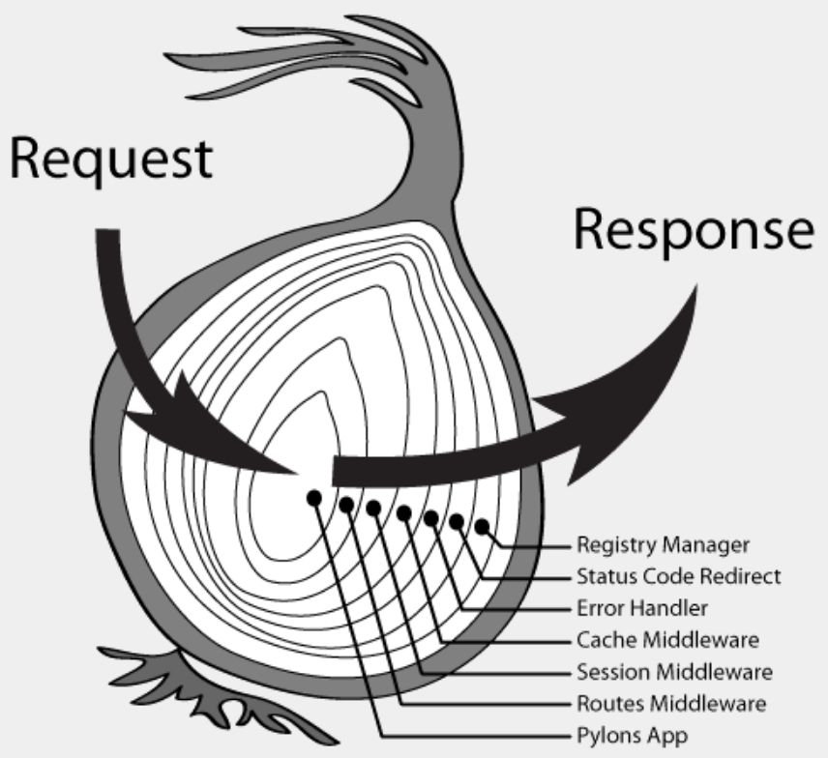
WSGI (Web Server Gateway Interface) (cont.)
Some developers have pushed WSGI to its limits as a protocol for middleware communications and develop web applications as an onion with many layers (each layer being a WSGI middleware developed independently of the entire framework)
Notes:
http://blog.ez2learn.com/2010/01/27/introduction-to-wsgi/
reuse
flexible

Slide 29
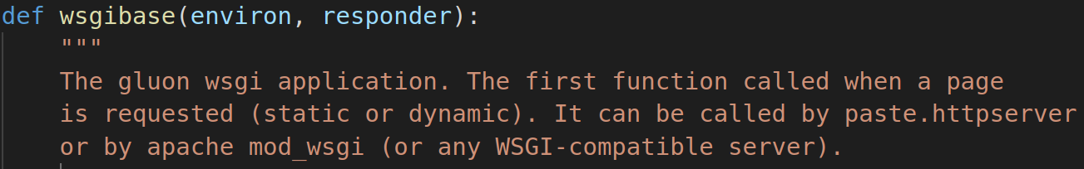
WSGI (Web Server Gateway Interface) (cont.)
web2py does not adopt this structure internally. This is because they feel the core functionality of a frameworks (handling cookies, session, errors, transactions, dispatching) can be better optimized for speed and security if they are handled by a single comprehensive layer.
web2py at its core is a WSGI application: gluon.main.wsgibase

Slide 30
WSGI (Web Server Gateway Interface) (cont.)
wsgibase (a single comprehensive layer)
Register Manager
Keep track of which of the Pylons global variables should be used in each thread of execution
Status Code Redirect
Catch responses with certain HTTP status codes and internally redirects the request to the error controller
Error Handler
Catch any exceptions that have occurred during the processing of a request

Slide 31
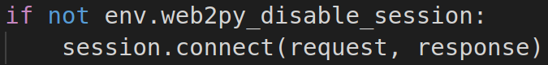
WSGI (Web Server Gateway Interface) (cont.)
wsgibase (a single comprehensive layer)
Cache Middleware
Provide the caching facility
This allows it to be used as a decorator for caching actions and views.
Session Middleware
Provide the session functionality
Routes Middleware
Match a URL against the route map

Slide 32
Third party WSGI applications and middleware
web2py allows you to use third party WSGI applications and middleware in three ways (and their combinations)
External middleware
Internal middleware
Calling WSGI applications

Slide 33
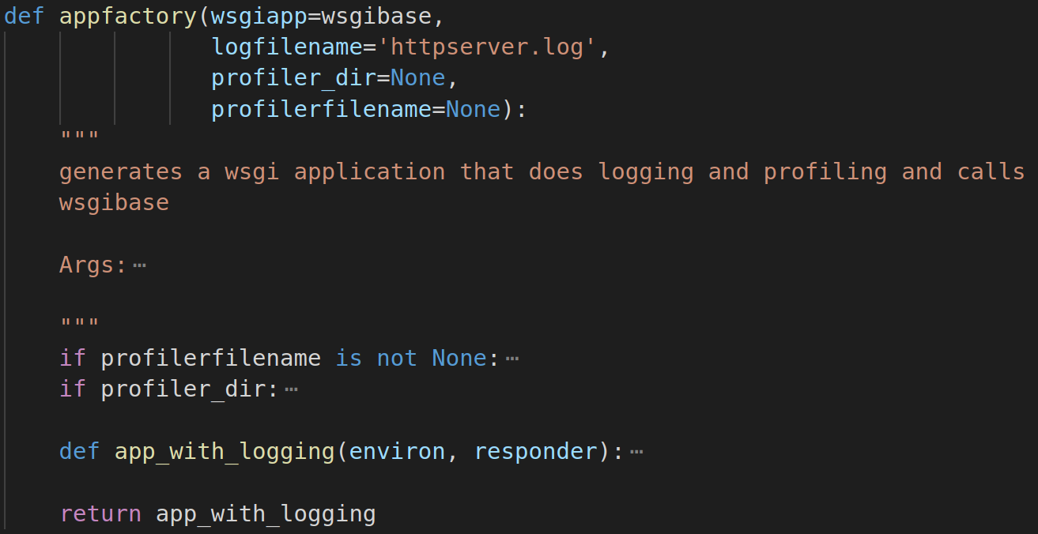
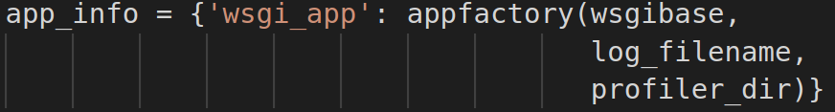
Third party WSGI applications and middleware (cont.)
External middleware (Add any third party middleware)
wsgibase is wrapped by the middleware function appfactory
In a similar fashion you can add any third party middleware

Slide 34
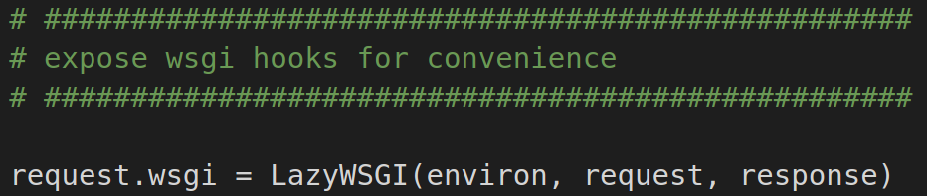
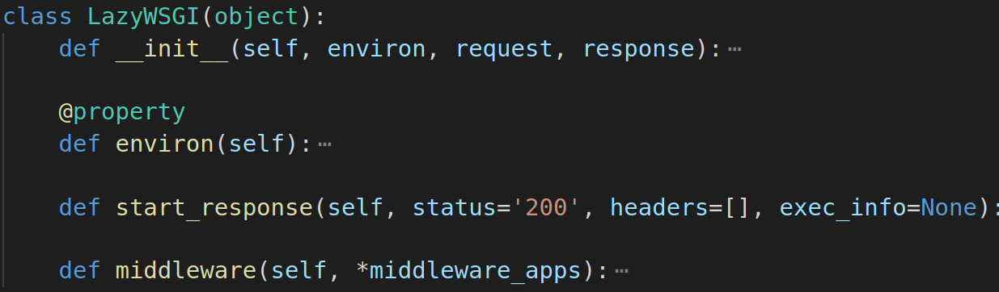
Third party WSGI applications and middleware (cont.)
request.wsgi
A hook that allows you to call third party WSGI applications from inside actions or decorate functions with WSGI middleware

Slide 35
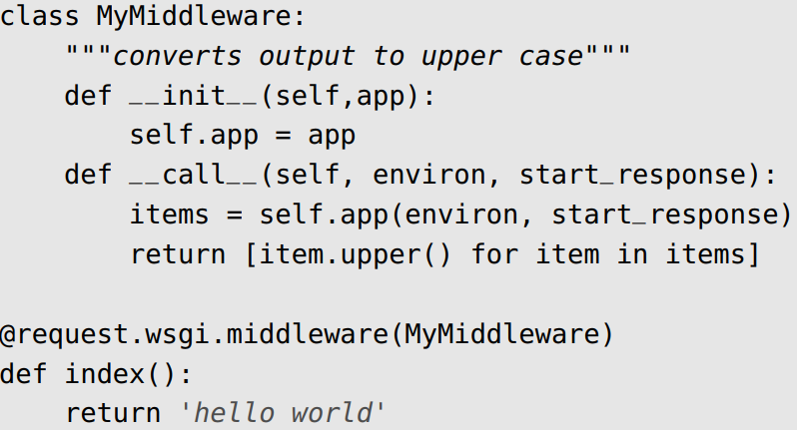
Third party WSGI applications and middleware (cont.)
Internal middleware
You can use a web2py decorator to apply the middleware to the action in your controllers

Slide 36
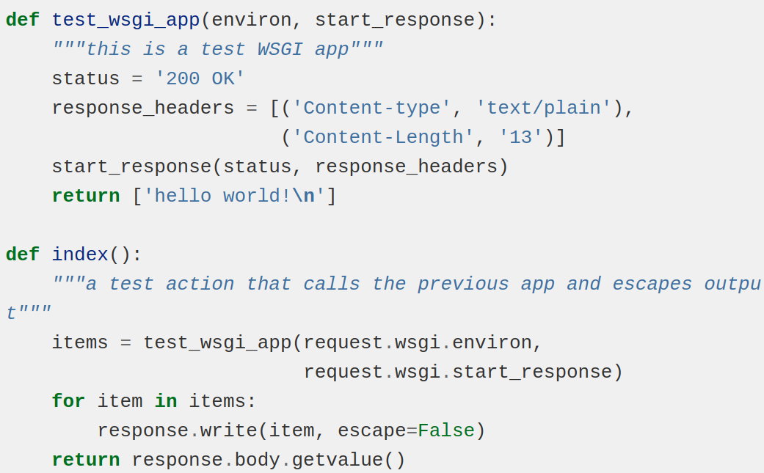
Third party WSGI applications and middleware (cont.)
Calling WSGI applications
Call WSGI app from a web2py action
An example:

Slide 37
Request to controller

Slide 38
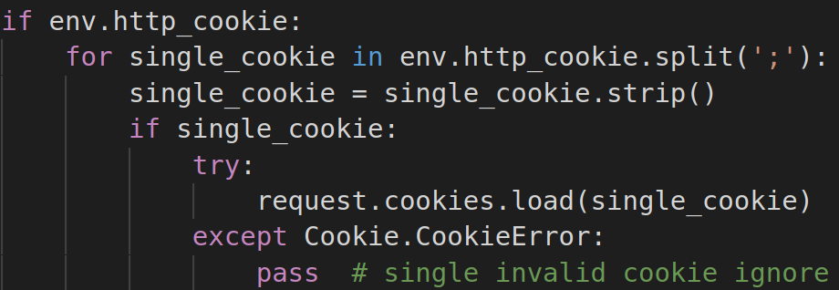
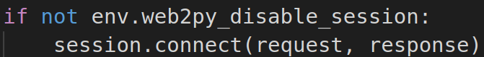
Cookies & Session
Use the Python cookies modules for handling cookies
Session is an instance of the Storage class
Trying to access an attribute/key that has not been set does not raise an exception; it returns None instead
Load cookies
Try to load session or create new session file
By default sessions are stored on the filesystem and a session cookie is used to store and to retrieve the session.id

Slide 39
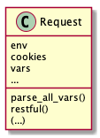
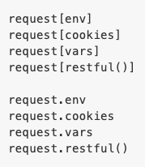
Storage: the ubiquitous web2py class
Extends the Python dict class
Basically a dictionary, except that the item values can be accessed as attributes
Unlike dict, trying to access a item/attribute that has not been set, it returns None instead of raising an exception

Slide 40
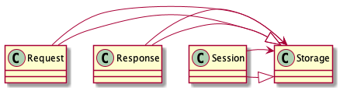
Storage: the ubiquitous web2py class
Multiple instances throughout web2py: Request, Response, Session, env, vars, global_settings, user, router, etc., and these instances can include other Storage items/attributes
Instead of segregating implementation from interface, web2py often opts to check if one Storage attribute exists

Slide 41
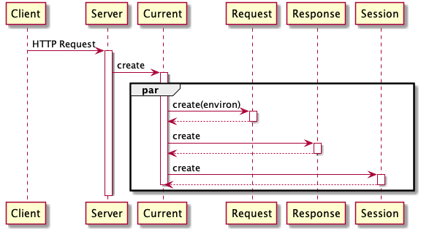
Current Container
A thread-local container that stores some global objects request, response, session, T, cache, etc.
Modules can only access them when they are called from an application

Slide 42
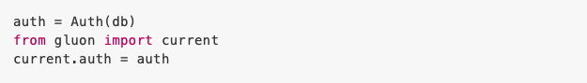
Current Container
Different users can call the same action index concurrently, which calls the function in the module
Yet with no conflicts because current.request is a different object in different threads
current and import create a powerful mechanism to build extensible and reusable modules for applications Now all modules can access current.auth!

Slide 43
Cookies & Session
Cookies and Session are dealt within main, the main WSGI application that performs all common tasks and wraps user applications
Session cookies enable the website to keep track of user movement from page to page
In web2py, sessions are stored on the filesystem and a session cookie is used to store and retrieve the session_id by default
Cookies from the browser are in request.cookies and those sent by the server are in response.cookies

Slide 44
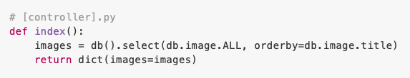
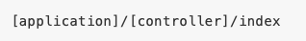
Session
An instance of Storage: whatever is stored can be retrieved as an attribute
The dispatcher decides which of the installed action will handle the request and maps the path in the URL into a function call
Static files - stored in the application's static subfolder
Handled directly, while large files are streamed directly to the client
Anything else - mapped into an action, where session comes into play before the action is called

Slide 45
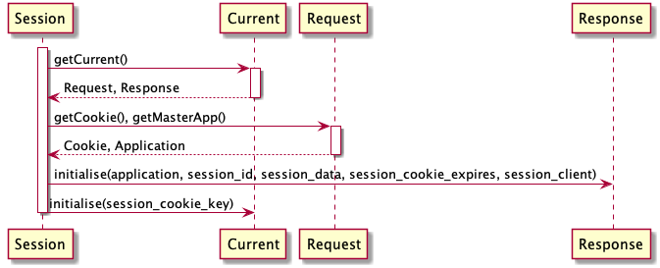
Connect Session
Try to load session or create new session file
Parse cookies
If the request header contains a session cookie for the app, the session object is retrieved
If not, a session id is created (but the session file is not saved until later)

Slide 46
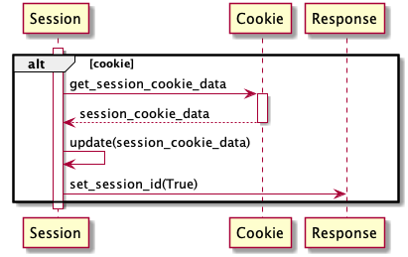
Connect Session
Store session in cookie
Check if there is session data in cookies

Slide 47
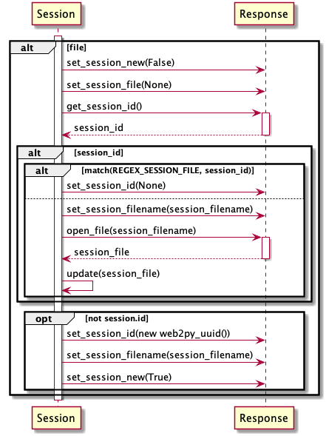
Connect Session
Store session in filesystem
Check if session_id points to a valid session filename
check_client: if True, sessions can only come from the same ip. Used to detect cookie attacks
separate: if True, creates a folder with the 2 initials of session_id. Useful when file system access becomes a bottleneck.

Slide 48
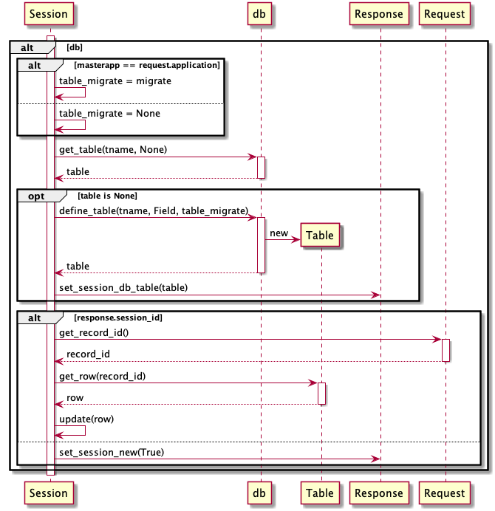
Connect Session
Store session in db
masterapp: point to another app's session
migrate: passed to the underlying db
Get session data out of the database

Slide 49
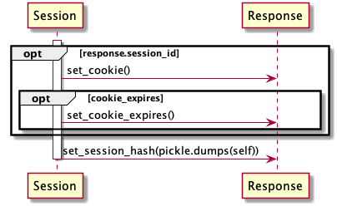
Connect Session
Wrap up
Set cookies if we know the session_id so user can set cookie attributes in controllers/models
cookies_expires: cookie may be reset later

Slide 50
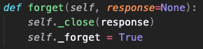
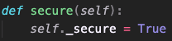
Forget & Secure Session
Session.forget()
Tell web2py not to save the session
Prevent the session file from being written
Used in controllers whose actions are called often and do not need to track user activity
Session.secure()
Tell web2py to save the session cookie to be a secure cookie
Prevent the browser from sending the session cookie back to the server unless over an https connection
Set if the app is going over https

Slide 51
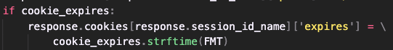
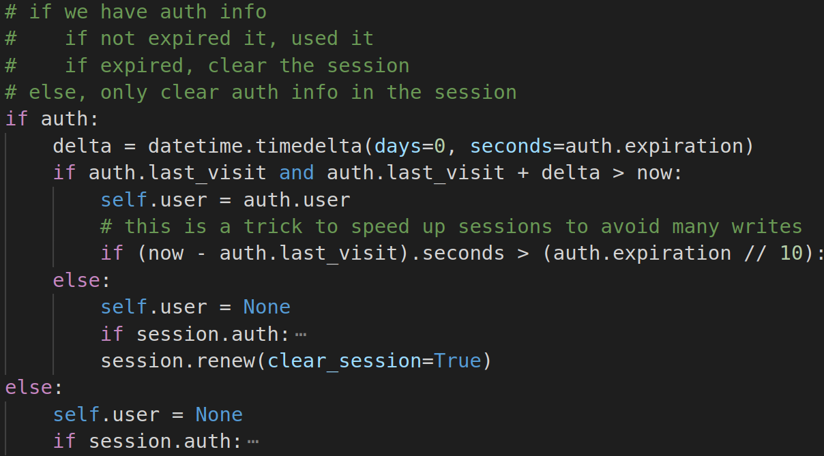
Cookie Expiration
Session.connect()
User-defined cookie expiration time
Session.renew()
Clear all session data if session expires
example: AuthAPI

Slide 52
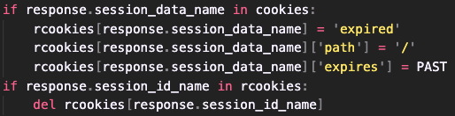

Cookie Expiration
Session.clear_session_cookies()
Expire session data saved in cookies
Delete session in cookies
Session.save_session_id_cookie()
Expire session data if there is no session cookie key
Copy the expiration information of session cookie to response
Used when session is stored in database or filesystem

Slide 53
Request to controller

Slide 54
Run Application
Build environment for controller and view
Build environment for controller and view
web2py model and controller files are not Python modules
models and controllers are designed to be executed in a prepared environment that has been pre-populated with web2py global objects (request, response, session, cache and T) and helper functions.
process models, controller and view
(if required)
Notes:
language translator
Strings that are marked with T are identified by web2py as needing language translation and they will be translated when the code (in the model, controller, or view) is executed

Slide 55

Run Application (cont.)
The controller and the view are executed in different copies of the same environment
The view does not see the controller, but it sees the models and it sees the variables returned by the controller action function
The view is only called if the action returns a dictionary

Slide 56

Execute application code in restricted environment
Application code is compiled and executed with exec() in a try...except... block
Any error in the application code is catched, and the error information is stored into a database table

Slide 57

Sequence diagram of handling error

Slide 58
Outline
Briefly introduce web2py
Request to Controller
Server
Rewrite and parsing incoming URLs
WSGI hooks
Cookies & Session
Run Application
Services
Views
Cron & Scheduler
PyDAL
Conclusion

Slide 59

Restful Web Services
A client communicates with the resource by making an HTTP request to the URL that identifies the resource and using the HTTP method POST/GET/PUT/DELETE to pass instructions to the resource
For example, we might want to send a GET request to
To create a restful action in web2py
request.restful provides a very useful decorator that can be used to change default web2py behaviour

Slide 60

Restful Web Services

Slide 61
Restful Web Services
web2py uses inner functions to define factory functions
A function that creates other objects (functions)
Add function request.restful() dynamically to another object or class

Slide 62

Restful Web Services
Modify restful action in web2py
@request.restful() decorator
Make sure that the extension (.html, .xml, .json) is stored in request.extension
Map the request method into the corresponding function within the action (GET, POST, PUT, DELETE)
Pass request.args and request.vars to the selected function

Slide 63


Remote Procedure Calls
web2py provides a mechanism to turn any function into a web service
Work for a fixed set of protocols; not easily extensible
May take arguments or be defined in a model instead of controller
Decorate functions to expose as a service

Slide 64
Outline
Briefly introduce web2py
Request to Controller
Server
Rewrite and parsing incoming URLs
WSGI hooks
Cookies & Session
Run Application
Services
Views
Cron & Scheduler
PyDAL
Conclusion

Slide 65

How the Client Gets Data

Slide 66

XML Elements: Helpers for HTML Tag
Create HTML tags with Python functions
Doing miscellaneous stuffs (e.g., escaping)
def index(): import gluon.html return gluon.html.SPAN("Hello World <3") # client gets <span>Hello World &lt;3</span>

Slide 67
Yet Another Template Language (YATL)
A template language similar to Django’s templates or Flask’s Jinja2
Allow using control flow statements of Python
A template can extend another one
Often used with HTML tag helpers to generate HTML with ease
The main class, TemplateParser, does both parsing and transformation to Python
{{ if authenticated: }} {{=T("Good!")}} {{ else: }} {{=T("Oops")}} {{ pass }}
if authenticated: response.write(T("Good!")) else: response.write(T("Oops")) pass

Slide 68
Extension of Templates
layout.html
<html><head> {{ block head }} <title>{{ block title }}web2py view{{ end }}</title> {{ end }} </head><body></body></html>
block: contents that can be replaced
super: place the content from the base
extends: for template reuse
index.html
{{ extends "layout.html" }} {{ block head }} {{ super }} <link rel="stylesheet" href="index.css" /> {{ end }} {{ block title }}Index{{ end }}
<html><head> <title>Index</title> <link rel="stylesheet" href="index.css" /> </head><body></body></html>

Slide 69
Parsing YATL
BlockNode
<head>
{{ block head }}
<title>{{ block title }}web2py view{{ end }}</title>
{{ end }}
</head>
Content
<head>
block
head
</head>
Node
<title>
block
title
</title>
web2py view

Slide 70


Class Diagram for YATL
Composite Pattern

Slide 71

How the Parser works
For {{ block }}
Problem: need to change the parser whenever a expression changes
For {{ end }}
For {{ super }}

Slide 72

No Interpreter Pattern
Encapsulate what varies
Actions for different nodes to different Expression classes
Abstract common behaviors
An AbstractExpression class for various Expression classes

Slide 73

No Observer Pattern
MVC frameworks use the observer pattern
But what web2py returns to the client are static HTML
Actually “Model 2”
Java Swing MVC
Where the observer pattern appears, but web2py does not implement it.

Slide 74

Languages.py
Translation system
Only one class named TranslatorFactory is used
Its work is translating key words into appointed language
TranslatorFactory is not factory pattern, but like an initial design

Slide 75


Languages.py

Slide 76

Languages.py
Re-design with strategy pattern
Because of Python’s property , omitting the interface is allowed

Slide 77
Outline
Briefly introduce web2py
Request to Controller
Server
Rewrite and parsing incoming URLs
WSGI hooks
Cookies & Session
Run Application
Services
Views
Cron & Scheduler
PyDAL
Conclusion

Slide 78
Time-Based Job Scheduler - Cron
Provides the ability for applications to execute tasks at preset times
Running periodical tasks in the background
Each task runs in its own process
Can’t control how many tasks are running
Three types of cron
Softcorn
Hardcorn
External corn

Slide 79



Time-Based Job Scheduler - Cron(cont.)
Call classes or methods directly by options

Slide 80

Time-Based Job Scheduler - Cron(cont.)
Build 2 pools at initialization (while web2py uses only 1 pool)
For softcorn
For hardcorn

Slide 81


Class Diagram of Cron
A simplepool contains instances of
Worker or SoftWorker
Lazy initialization
Object pool pattern

Slide 82

Lazy Initialization and Object Pool
Create an object when it is called and no other objects are available
Reuse the created object
Creating a thread consumes many resources

Slide 83


Scheduler
An optional and independent class in web2py
Access information from PyDAL
Dependency injection - property Injection
Monitor each worker & assign tasks to each worker
What about the original web2py? (without Scheduler)
Task may stuck at worker
Can’t access the progress of tasks

Slide 84

Class Diagram of Scheduler
The number of running processes (worker)
is fixed
They can run on different machines
Check all workers after a heartbeat
Any worker may be a ticker
Only ticker can assign tasks to other workers

Slide 85

Sequence Diagram of Scheduler

Slide 86

Task State Transition
timeout passed
Timeout
Assigned
Running
exception detected
Queued
Failed
Expired
all work normally
stop time passed
Completed

Slide 87
Outline
Briefly introduce web2py
Request to Controller
Server
Rewrite and parsing incoming URLs
WSGI hooks
Cookies & Session
Run Application
Services
Views
Cron & Scheduler
PyDAL
Conclusion

Slide 88
PyDAL outline
PyDAL introduction
PyDAL workflow
conclusion

Slide 89


What is PyDAL
PyDAL stands for Python Data Abstraction Layer
A Python module that can access different types of databases
Written by web2py author and can be used alone

Slide 90
DAL
Able to access different types of databases
SQLite, MySQL, Oracle, MongoDB, PostgreSQL, MSSQL, FireBird, ...

Slide 91




DAL class

Slide 92



parse

Slide 93

Dependency Injection
Inject a SQLite class
Adapter has different adapters
Dependency Pool:
MySQL, Oracle
SQLite, ...

Slide 94


What adapters can do
Translate all fields’ operations into its own dialect (SQLiteDialect)
Connect to the database via specific module (from sqlite3 import dbapi2)
Parse response string using (if needed) based on its own parser (SQLiteParser)
Extra query (ST_Geomtry) using its representers (SQLiteRepresenter)

Slide 95




Injection of Dialect, Parserm, Representer, Connection module

Slide 96




Dialect
Map types and operations into specific strings
Prepare query strings

Slide 97




Representer
Type definition (string, int)
Custom type, ex: ST_Geomtry
Used by Dialect to determine transformed string

Slide 98



DRIVER
Connect to database
Send requesta and receive responses

Slide 99



Connection
defined in pyodbc
odbc
open database connectivity
support standard API to access DBMS

Slide 100





ConnectionPool
Instantiate a connection beforehand
Pop up an available worker to access DB
Notes:
use cursor to not load lots of return results immediately
each cursor represent that holding a row in a table
can operate simultaneously (holding a cursor in a row, others can still read, update or delete other rows in same table)
should deal with concurrency issues

Slide 101




Parser
Parse the return string iterativelly
to a specific format

Slide 102


Subsystem

Slide 103

Base Class Subsystem
SQLite Subsystem

Slide 104


Database Abstraction Layer (DAL)
Maps Python objects into database objects

Slide 105


Target

Slide 106

Initialization

Slide 107



Adapter

Slide 108


Adaptee

Slide 109


Adapter Pattern
Object Adapter

Slide 110
Table, Row, Field
PyDAL has classes like
Table
Row
Field

Slide 111





Define Table
User can specify on demand table creation
LAZY_TABLE
Actually create table in DB

Slide 112

Get records
Parser returns Rows which
includes lots of Row instances

Slide 113





Iterate records
Support Rows and IterRows
Rows holds all the rows parsed by parser
IterRows holds only cursor (Connection) to get record one by one
IterRows will not be overwhelmed by the result from DB and can print out continuously

Slide 114

BasicRows
Rows / IterRows
__iter__ should be
encapsulated and abstracted

Slide 115



Slide 116

PyDAL vs ORM
Parse return string to Row
Aggregate all rows to Rows
Notes:
PyDAL:
all tables mapped to one data structure Rows
ORM:
Different table different class

Slide 117
PyDAL conclusion
Use adapter to connect DAL with database
Use dependency injection to inject different adapters
Has connection pool to hold intialized connections
Lazy table mechanism
Different iteration implementation
Not ORM

Slide 118
Conclusion (web2py)
Model 2 architecture
Most of design are initial design, web2py is hard to maintain. Breaking down the system into definable elements is difficult because it is not loosely coupled
Provides some interesting mechanisms with Python e.g. dynamically typed, function decorators, Storage

Slide 119
Conclusion (SED)
Differences between Python and Java make design patterns not completely the same
The importance of code design. It enables better maintainability for applications
Cooperation among team members - implementing codes together
Better understanding of processes and designs of web frameworks
The concept of design process for changes can be applied to various scenarios
A life-changing experience

Slide 120






Thank you
Merry Christmas !!!

Slide 121

Appendix

Slide 122

Appendix

